Slide 1

Java Threads

Slide 2
Content
Concepts. Threads and Processes
Threads Lifecycle
Mutual Exclusion
Locks
Liveness

Slide 3
Process & Threads
Process
Software that uses resources for his own, like (RAM, etc).
Process == program
Thread
A lightweight “process” that shares resources within a process. Many threads in process. They can communicate with each other.
Asynchronous
Piece of SW that runs separately from the main thread and notifies the calling thread when finished.
It's NON_BLOCKING.
It's not multithreading, but relies on multithreading.
Note: See windows manager
https://medium.com/@tomaslingotti/asynchronous-multithreading-parallel-and-concurrent-programming-e834073083ce

Slide 4
Multithreading – Concurrent vs Parallel
Multithreading. Run another thread apart from the main thread to execute a task.
Concurrency. Be able to handle different tasks that appear to be run simultaneously.
Parallelism. Run tasks at the same time. Need multi-core hardware.
Task 1
Task 2
Task 1
Task 2

Slide 5
Creating threads in Java
Extending Thread class.
Implementing Runnable interface.
Inline as lambda or anonymous class

Slide 6




Let’s code: Creating threads
New thread
Different ways to create threads
join(), getName(), getId(), currentThread()

Slide 7
Thread Lifecycle
New
NEW
RUNNABLE
BLOCKED
WAITING
TIMED_WAITING
TERMINATED
Waiting
Start
Runnable
Blocked
Finish
Resume
Terminated

Slide 8
Let’s code: Thread Lifecycle
getState()

Slide 9

Time to play
https://kahoot.it

Slide 10
Mutual Exclusion (Mutex)
Data Race
When two or more concurrent threads access the same memory location and at least one is trying to modify its value.
Critical Section
Segment that access a shared resource.
It shouldn’t be accessed by more than one thread at a time
Lock
Mechanism to implement mutual exclusion.
Only one thread possess it at a time and limits the access to the critical section.
Atomic Operation
Executes a single action.
It cannot be interrupted by other threads.
Keep the protected code the shortest possible and be mindful!
https://docs.oracle.com/cd/E19205-01/820-0619/geojs/index.html

Slide 11
Let’s code: Mutual Exclusion
Lock → ReentrantLock
lock(), unlock()
Atomic classes
Synchronization

Slide 12
Mutual Exclusion (Mutex) – Contd.
Intrinsic/monitor Lock.
Implicit internal entity associated with each instance. It enforces exclusive access to an object’s state.
In other words, every object in Java has internally a lock.
Two ways to acquire the intrinsic lock of an object:
Synchronized method
it automatically acquires the intrinsic lock for that method's object and releases it when the method returns. Even with exceptions.
Synchronized statement/block
They must specify the object that provides the intrinsic lock.
https://docs.oracle.com/javase/tutorial/essential/concurrency/locksync.html

Slide 13
Let’s code: Mutual Exclusion – contd.
Synchronization
Method
Statement (class object vs primitive vs wrapper)

Slide 14
Locks
Reentrant lock
Locks a mutex multiple times by the same thread before unlocking it.
Needs to be unlocked the same number of times as it was locked before another thread can lock it.
Nested method calls and recursive methods.
Try lock
It is like a non-locking version of locks. It attempts to acquire the lock immediately, returning true if successful and false if not.
Read-write lock
Allows multiple threads to read a value as long as non of the threads write the shared mutex. I.e. Write uses an exclusive lock while Read uses a shared lock.
Many readers, few writers
Deadlock:
All processes and threads are unable to continue executing
What’s is a deadlock?
https://www.concretepage.com/java/reentrantlock-java-example-with-lock-unlock-trylock-lockinterruptibly-isheldbycurrentthread-and-getholdcount

Slide 15
Let’s code: Locks
Lock interface
ReentrantLock class
tryLock
ReentrantReadWriteLock class

Slide 16
Time to play
https://kahoot.it

Slide 17
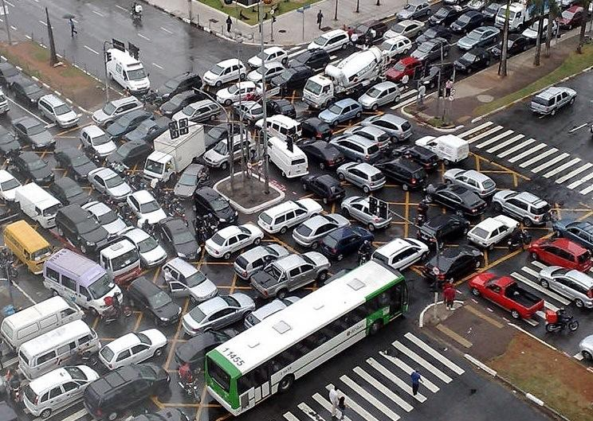
Liveness vs Deadlock
Thread 1
Resource 2
Thread 2
Resource 1
Liveness
A concurrent application's ability to execute in a timely manner.
A set of properties that require a system to make progress.
Members may have to take turns in critical sections.
Deadlock A situation where a set of processes are blocked because each process/thread is holding a resource and waiting for another resource acquired by some other process/thread.
Owned by
Waiting for
Waiting for
Owned by
https://www.geeksforgeeks.org/introduction-of-deadlock-in-operating-system/
https://docs.oracle.com/javase/tutorial/essential/concurrency/liveness.html

Slide 18
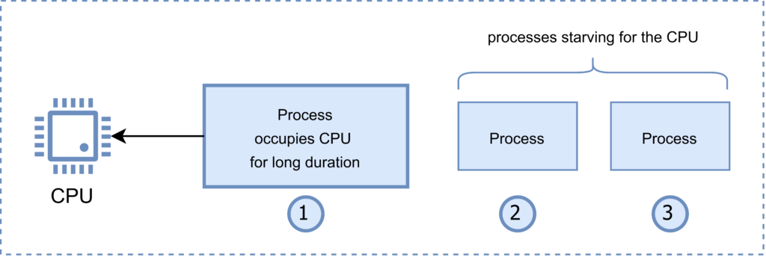
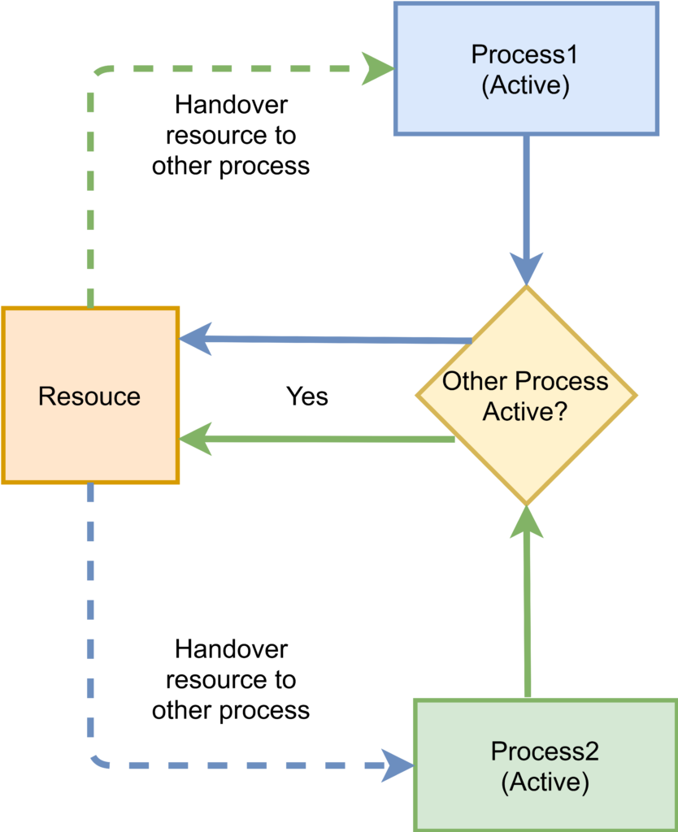
Abandoned lock, Starvation, and Livelock
Abandoned lock. Errors occurring when a thread traps some resource and is withdrawn from execution for some reason. As the result the resource cannot be released. If another thread needs it this will lead to infinite waiting.
Starvation. A process is unable to gain regular access to the shared resources it requires to complete a task and thus, unable to make any progress.
Livelock. A deadlock-like situation in which multiple threads or processes are actively responding to each other to resolve conflict, but that prevents them from making progress.
https://pvs-studio.com/en/blog/terms/
https://www.baeldung.com/cs/deadlock-livelock-starvation

Slide 19
Let’s code: Deadlocks
A simple deadlock
Abandoned locks

Slide 20
Safety and Liveness properties
Property:
Safety property. stipulates that some 'bad thing' does not happen during execution
Mutual Exclusion
Deadlock freedom
Partial correctness
First-come-first-serve
In mutual exclusion, the proscribed 'bad thing' is two processes executing in critical sections at the same time. In deadlock freedom it is deadlock. In partial correctness, it is terminating in a state not satisfying the postcondition after having been started in a state that satisfies the precondition. Finally, in first-come-first-serve, which states that requests are serviced in the order they are made, the 'bad thing' is servicing a request that was made after one not yet serviced.
Liveness property. stipulates that a 'good thing' happens during execution.
Starvation freedom
Termination
Guaranteed service
In starvation freedom, which states that a process makes progress infinitely often, the 'good thing' is making progress. In termination, which asserts that a program does not run forever, the 'good thing' is completion of the final instruction. Finally, in guaranteed service, 2 which states that every request for service is satisfied eventually, the 'good thing' is receiving service.
https://www.cs.cornell.edu/fbs/publications/DefLiveness.pdf

Slide 21

Resources
https://www.baeldung.com/java-thread-safety
https://www.baeldung.com/java-atomic-variables
https://www.linkedin.com/learning/parallel-and-concurrent-programming-with-java-1
https://docs.oracle.com/javase/tutorial/essential/concurrency/index.html

